Slide 1

NETA PowerPoint® Slides
to Accompany
Prepared by
Katharine Ferguson,
Seneca College

Slide 2
The Job Search and Résumés
Chapter 15

Slide 3
Unit 5 Employability Skills
Fundamental Skills
Communicate
Manage Information
Think and Solve Problems
Personal Management Skills
Demonstrate Positive Attitudes and Behaviours
Be Responsible
Be Adaptable
Learn Continuously
Teamwork Skills
Work With Others
Participate in Projects and Tasks

Slide 4
Job Searching in the Digital Age
Job search trends
Job search strategies
Customized résumé
Job search with digital tools
Customized cover letter

Slide 5
Latest Trends in Job Searching and Résumés
Use of mobile technologies is on the rise.
Networking—it’s who you know.
Communication and interpersonal skills are in high demand.
Social media presence is a must.
It’s all digital (e-mail, Internet job boards, and Web pages).
Résumés must please scanners and skimmers.

Slide 6
Using Technology to Aid Your Job Search
Organizations bet on technology.
It’s an employers’ market—what the employer wants.
The résumé is not dead—it is read digitally rather than in print and should always be available and current.
Notes:
Nearly every job hunter today has at least one mobile device, and the number of apps for these devices is overwhelming. You can download apps to plan your career, organize the job-search process, scour numerous job boards, and receive immediate job alerts.

Slide 7
Four-Step Job Search Process
Analyze yourself.
Develop a job-search strategy.
Prepare a résumé.
Know the hiring process.

Slide 8
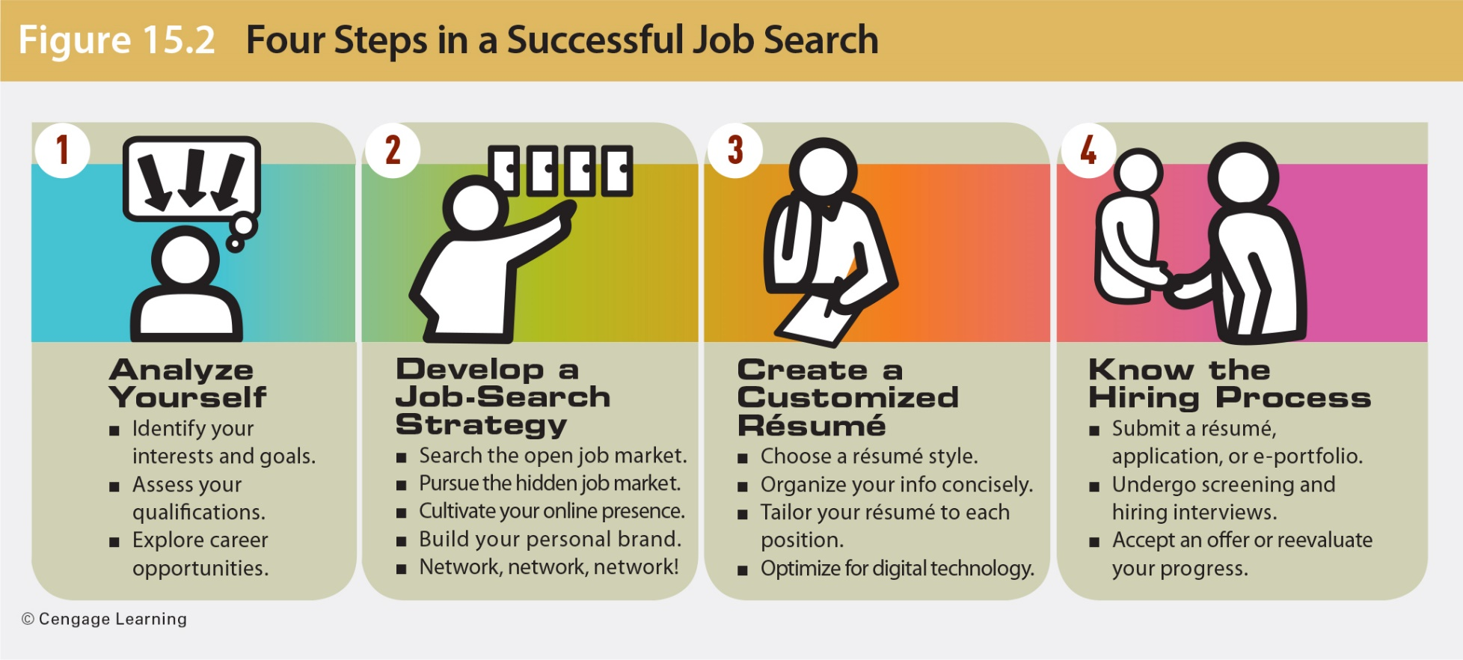
Job Searching in the Digital Age

Slide 9
Your Job Search With Self-Analysis
Analyze your interests and goals, and evaluate your qualifications.
Consider the following:
What are you passionate about? Can your passion become a career?
Do you enjoy working with people, data, or things?
Would you like to work for someone else or be your own boss?
How important are salary, benefits, technology support, and job stability?

Slide 10
Your Job Search With Self-Analysis
Consider the following:
How important are working environment, colleagues, and job stimulation?
Must you work in a specific city, geographical area, or climate?
Are you looking for security, travel opportunities, money, power, or prestige?
How would you describe the perfect job, boss, and coworkers?

Slide 11
Exploring Career Opportunities
Visit your campus career centre.
Search the Web.
Use your library.
Take a summer job, internship, or part-time position in your field.
Interview someone in your chosen field.
Volunteer with a nonprofit organization.
Monitor the classified ads.
Join professional organizations in your field.

Slide 12
Evaluating Your Qualifications
What assets do you have?
What technology skills can you present?
Do you communicate well in speech and in writing? Do you know another language?
How can you verify these talents?
What other skills do you have?
Do you work well with people? Do you enjoy teamwork?
Are you a leader, self-starter, or manager?
Do you learn quickly? Can you think critically?

Slide 13
Investigating Career Opportunities
Visit your campus career centre.
Talk to career counsellors, take workshops, read literature, use career-related software.
Search for apps and online help.
Check job-search sites like Monster, CareerBuilder, and Workopolis and apps like iPQ Career Planner.
Use your library.
Print and online resources are helpful.
Notes:
Career information can be obtained from campus career centres and libraries, the Internet, classified ads, and professional organizations.
Job boards list many jobs, but finding a job requires more work than merely clicking a mouse. Job boards now face competition from social networking sites such as LinkedIn, Facebook, and Twitter.
Job boards serve as a jumping-off point in most searches. They can inform you about the kinds of jobs available and the skill sets required. The best-known job boards provide tips on job-searches résumés, interviewing, and salary.
Job prospects may be more promising at the websites of corporations, professional organizations, employers’ organizations, and niche fields like HealthCareerWeb.com.

Slide 14
Investigating Career Opportunities
Take a summer job, internship, or part-time position in your field.
Nothing is better than trying out a career.
Interview someone in your chosen field.
Inquire about skills, required courses, financial and other rewards, benefits, etc.
Volunteer with a non profit organization.
Gain valuable experience.
Monitor the classified ads.
Begin monitoring want ads and websites of companies in your career area.

Slide 15
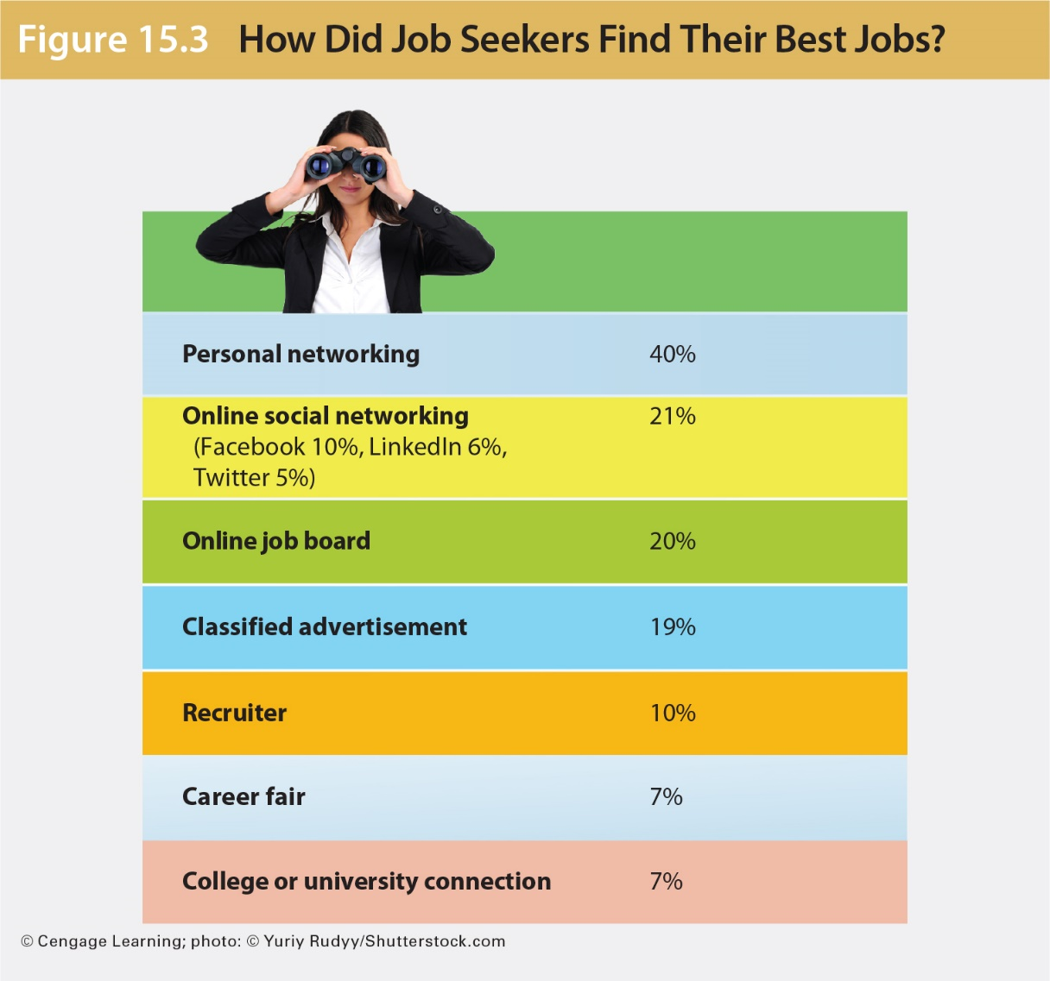
How Job Seekers Found the Best Jobs

Slide 16
Searching the Open Job Market
Explore the big boards.
General sites include Career Builder, Monster.ca, Wowjobs.ca, Workopolis, TalentEgg, Jobbank.gc.ca, Indeed.ca
Pursue company leads.
Search for job openings on a company’s own website. Even if the company not hiring, send your résumé and cover letter.
Notes:
Company websites may provide vision and mission statements, a history of the organization, and the names of hiring managers.

Slide 17
Searching the Open Job Market
Check niche sites.
Check sites like HealthCareerWeb.com and SixFigureJobs.com for jobs in specialized fields.
Take advantage of mobile apps
Smartphone apps like Indeed Job Search let you filter search results.
Check newspapers, career fairs, and other sources.
Do not overlook these possibilities.

Slide 18
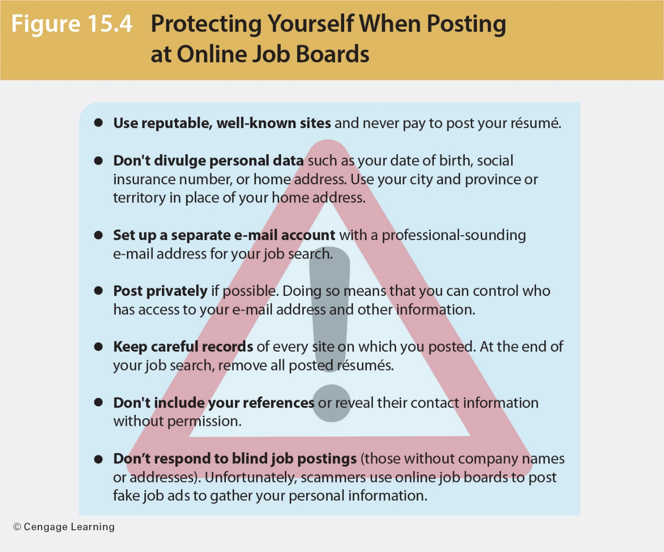
Protecting Yourself When Posting on Online Job Boards

Slide 19
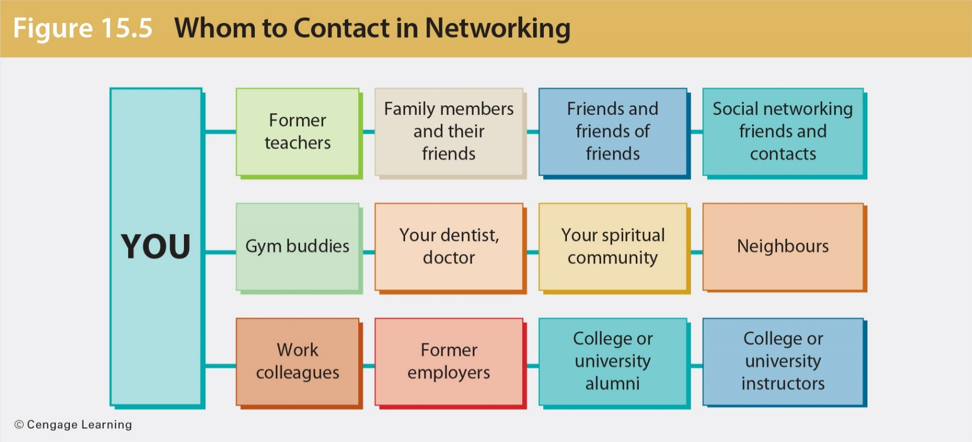
Building a Personal Network
Notes:
Before showing students this slide, ask them how they network for job opportunities, whether summer or other jobs.

Slide 20
Targeting Social Media in a Job Search
Letting LinkedIn help you find a job
Dominates the world of job searching and recruiting
Used by 95 percent of recruiters as a recruiting tool
Enables you to post information about yourself in one central place where it is available to potential employers, graduate schools, future colleagues, and network connections
Notes:
Having a LinkedIn page tells the working world that you are a professional, and it remains significant even after you obtain a position.

Slide 21
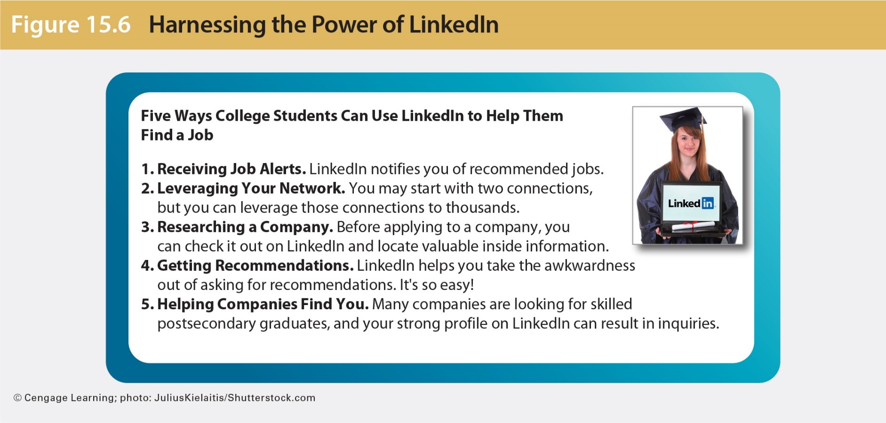
Harnessing the Power of LinkedIn
Notes:
Ask students how many of them have LinkedIn accounts and what kinds of information they have posted on their accounts. What was their reason for creating a LinkedIn profile?

Slide 22
Targeting Social Media in a Job Search
Enlisting other social networks in a job hunt
Facebook, Twitter, and Google+ can help you find job opportunities, market yourself, showcase skills, highlight experience, and possibly land a dream job.
Nine out of 10 recruiters use social media to search, monitor, and vet candidates before the interview.
Notes:
You can make yourself more discoverable by posting thoughtful blog posts and tweets on topics related to your career goal.

Slide 23
Creating Your Personal Brand
Involves deciding what makes you special and desirable in the job market
Ask the following questions:
What is your unique selling point?
What special skill set makes you stand out among other candidates?
What would your instructors or employers say is your greatest strength?
What are you promoting about yourself?

Slide 24
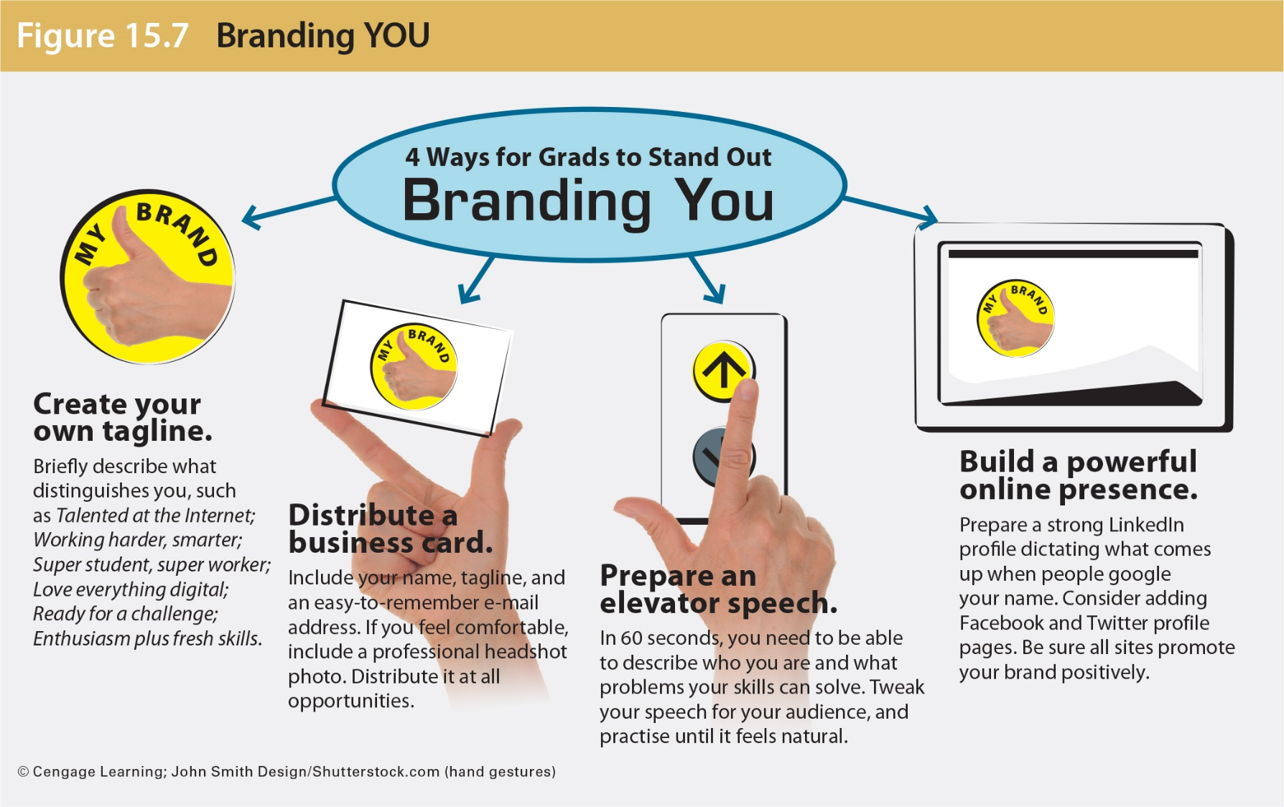
Developing Your Own Brand

Slide 25
Creating a Customized Résumé
What is a chronological résumé?
Focuses on job history, with the most recent positions listed first
Works well for those who have experience in the field of employment and who show steady career growth
Less appropriate for people who change jobs frequently or who have employment gaps

Slide 26

Choosing a Résumé Style
What is a functional résumé?
Focuses on a candidate’s skills rather than on past employment
Groups skills and accomplishments in special categories
Works for people who frequently change jobs or new graduates with no related employment experience

Slide 27
Organizing Your Information Into Effective Résumé Categories
Main Heading
List your name, address, phone number, and your personal e-mail address.
Career Objective
Include a well-written career objective customized for the job opening.
Consider including strategic keywords for tracking systems.
Focus on what you can contribute to the organization not on what the organization can do for you.
Notes:
The goal of the résumé is to win the interview. Having a current résumé makes you look well organized and professional, ready for the unexpected employment opportunity.
Recruiters may say they prefer one-page résumés, but many choose to interview candidates with longer résumés.
Career objectives are most appropriate for specific, targeted positions; they may limit a broader job search. Your objective should focus on your employer’s needs. It should be written from the employer’s perspective. Be careful that your objective doesn’t downplay your talents. Try to limit your objective to no more than three lines. Avoid using complete sentences and the pronoun I.

Slide 28
Organizing Your Information Into Effective Résumé Categories
Optional Summary of Qualifications
Provide three to eight bulleted statements to prove you are a good candidate.
Consider your most impressive qualifications: experience, skills, education, and awards.
Focus on nouns that might be selected as keywords by an applicant tracking system.
Notes:
A Summary of Qualifications section lists your most impressive accomplishments and qualifications in one concise bulleted list.

Slide 29
Organizing Your Information Into Effective Résumé Categories
Education
Include the name and location of your school, dates of attendance, major fields of study, and degrees received.
List your GPA in your major only.
Refer to your courses only if you can relate them to the position sought.
Notes:
The Education section shows degrees, diplomas, and GPA but does not list all courses a job applicant has taken. Refer to courses only if you can relate them to the position sought. One way to enhance your GPA is to calculate it in your major courses only (for example 3.6/4.0 in major). It is not unethical as long as you show it is for your major only.

Slide 30
Organizing Your Information Into Effective Résumé Categories
Work Experience or Employment History
List your jobs. Start with the most recent. Include the following:
Employer’s name, city, and province or territory
Dates of employment (month and year)
Most important job title
Significant duties, activities, and accomplishments
Volunteer work experience is considered relevant by 41 percent of hiring managers.
Notes:
When your work experience is significant and relevant to the position sought, this information should appear before education. List your most recent employment first and work backward. Your résumé may be selective, but time gaps in your employment history will probably be questioned in the interview.
Describe your employment achievements concisely but concretely. Avoid generalities; be specific. Your employment achievements and job duties will be easier to read if you place them in bulleted lists. Avoid using the pronouns I, me, and my. Select work experiences and achievements that illustrate your initiative, dependability, responsibility, resourcefulness, flexibility, and leadership.

Slide 31
Organizing Your Information Into Effective Résumé Categories
Work Experience or Employment History
Use action verbs to describe your experience.
Summarize significant duties, activities, accomplishments, and promotions:
Developed customer-service skills by successfully interacting with 40+ customers daily
Conducted research and wrote final study analyzing equipment needs of 100 small businesses in St. Catharines
Personally generated orders for sales of $90,000 annually
Notes:
Use action verbs in statements that quantify achievements.

Slide 32
Organizing Your Information Into Effective Résumé Categories
Capabilities and Skills
List special skills; include many nouns that relate to the targeted positions, your ability to use the Web, software programs, social media, office equipment, and communication technology.
Highlight exceptional aptitudes, such as working well under stress, learning computer programs quickly, and interacting with customers. Give evidence of communication, management, and interpersonal skills.
Certified in graphic design including infographics through an intensive 350-hour classroom program
Notes:
Recruiters want to know specifically what you can do for their companies. List your special skills. Include your ability to use the Web, software programs, social media, office equipment, and communication technology tools. If you speak a foreign language or use sign language, include it on your résumé. Describe proficiencies you have acquired through training and experience.

Slide 33
Organizing Your Information Into Effective Résumé Categories
Awards, Honours, and Activities
Show that you are well rounded.
List awards separately; include extracurricular activities, especially if they demonstrate leadership and interpersonal skills.
Collected dues, kept financial records, and paid bills while serving as treasurer of 35-member business management club
Notes:
If you have three or more awards or honours, highlight them by listing them under a separate heading. If not, put them in the education or work experience section, if appropriate. Include awards, scholarships (financial and other), fellowships, dean’s list, honours, recognition, commendations, and certificates.

Slide 34
Organizing Your Information Into Effective Résumé Categories
Personal Data
Omit personal data such as birth date, marital status, height, weight, national origin, health, disabilities, and religious affiliations.
Include hobbies and interests that may serve as conversation starters.
References
Don’t list references on a résumé; bring them to the interview.
Notes:
For references, consider three to five individuals, such as instructors, your current or previous employers, colleagues or subordinates, and other professional contacts. Ask if they would be willing to answer inquiries regarding your qualifications. Provide them with an opportunity to refuse. Do not include personal or character references such as friends, family, or neighbours.

Slide 35
Polishing Your Résumé and Keeping It Honest
Look for ways to improve your résumé.
Consider consolidating headings.
Consider graphic highlighting techniques to improve readability: capitalization, underlining, indenting, and bulleting.
Look for ways to eliminate wordiness.
Verify all the facts.
Showcase strengths and minimize weaknesses.
Notes:
Don’t be caught in a mistake, or worse, a distortion of previous jobs and dates of employment. These items likely will be checked and the consequences of puffing up a résumé with deception or lies are simply not worth the risk.

Slide 36
Proofreading Your Résumé
Proofread! Proofread! Proofread!
Check spelling, grammar, mechanics, content, and format.
Revise your résumé as you seek a variety of jobs.
Note: One typo, misspelled word, or grammatical error could eliminate you from consideration.

Slide 37
Maximize the Rank of Your Résumé
Include specific keywords or keyword phrases.
Focus on nouns: job title, position, or role; technical skills and certification.
Use variations of the job title as tracking systems may be seeking a slightly different job title from what you list.
Concentrate on the Skills section. The majority of keywords are for specialized or technical skills.
Keep the formatting simple.
Use conventional headings.

Slide 38
Showcasing Qualifications in a Career E-portfolio
Updated résumé and cover message
Reference letters
Commendations for special achievements, awards, certificates, work samples
Complete list of courses
Thank-you letters
Digital copies of Images, film projects, media files, blog entries

Slide 39
How Are E-portfolios Accessed?
They are generally accessed at websites.
Some postsecondary institutions make website space for student e-portfolios.
Institutions may provide instructions and resources for scanning photos, digitizing images, and preparing graphics.
E-portfolios can be burned onto CDs and DVDs to be mailed to prospective employers.

Slide 40
Expanding Employment Chances With a Video Résumé
It allows candidates to demonstrate their public speaking, interpersonal, and technical skills
Use YouTube, webcams, and broadband.
Dress professionally as you would for an in-person interview.
Keep the video to three minutes or less.
Explain why you would be a good employee and what you can do for the company.

Slide 41
How Many Résumés and What Format?
When a basic print-based résumé is useful:
During job interviews
For person-to-person networking situations
For recruiters at job fairs
When competing for a job that does not require electronic submission
Notes:
Print-based résumés are attractively formatted to maximize readability. An attractive print-based résumé is necessary (a) when you are competing for a job that does not require electronic submission, (b) to present in addition to an electronic submission, and (c) to bring with you to job interviews.
To screen incoming résumés, many mid- and large-sized companies use automated applicant-tracking software. These systems scan an incoming résumé with optical character recognition, looking for keywords. The most sophisticated programs enable recruiters and hiring managers to search for keywords, rank résumés based on the number of hits, and generate reports. It is important to call the company and ask whether it scans résumés electronically.
A plain-text résumé is an electronic version suitable for e-mailing or pasting into online résumé bank submission forms. Employers prefer plain-text résumés because they avoid possible e-mail viruses and word processing incompatibilities.

Slide 42
How Many Résumés and What Format?
Use a plain-text résumé for digital submission:
Available for e-mailing or pasting into online résumé submission forms
Helps avoid possible e-mail viruses and word processing incompatibilities
Usually included in the body of an e-mail message and is searchable

Slide 43
Submitting Your Résumé
Word document
Send your presentation résumé by surface mail or as an e-mail attachment.
Plain-text document
Embed within an e-mail or send as an attachment.
PDF document
Use Adobe software to convert your presentation résumé. Send it as an attachment.
Company database
Complete an online form with your résumé information.
Notes:
Send your résumé in the format the employer requests.

Slide 44
Creating Customized Cover Messages
A cover message should have
An opening that captures attention, introduces the message, and identifies the position
A body that sells the candidate and focuses on employer’s needs
A closing that requests an interview and motivates action

Slide 45
Gaining Attention in the Opening
For solicited jobs
Refer to the name of an employee in the company.
Refer to the source of your information precisely.
Refer to the job title and describe how your qualifications meet the requirements.
Notes:
Even if an advertisement doesn’t request one, be sure to distinguish your application with a customized cover letter (also called a letter of application). It has three purposes: (1) introducing the résumé, (2) highlighting your strengths in terms of benefits to the reader, and (3) gaining an interview.

Slide 46
Gaining Attention in the Opening
For unsolicited jobs
Demonstrate an interest in and knowledge of the reader’s business.
Show how your special talents and background will benefit the company.

Slide 47
Promoting Strengths in the Body
Demonstrate how your preparation and training fulfill the job requirements.
Choose your strongest qualifications and show how they fit the targeted job.
Discuss relevant personal traits and documentation that proves you possess these traits.
Refer to your résumé.
Notes:
The body of the cover letter promotes the candidate’s qualifications for the targeted job.

Slide 48
Motivating Action in the Closing
Ask for an interview. Consider hooking the request to a statement reviewing your strongest points.
Make it easy to respond. Tell when you can be reached (during office hours). Some recruiters prefer that you call them.

Slide 49
Sending Your Résumé & Cover Letter
Submit both your cover letter and résumé in an e-mail message.
Convert both to plain text.
Send your cover letter as an e-mail and your résumé as an attachment (plain text, Word document, or PDF).
Send a short e-mail message with both your cover letter and résumé
Send a printed cover letter or résumé by Canada Post.

Slide 50
Final Tips for Successful Cover Messages
Make activities and outcomes, not you, the subject of sentences.
Avoid sounding self-centred.
Use a traditional letter style, such as the block format.
Print on quality paper.
Proofread several times. Have someone else read it.
Don’t rely on spellcheck to find all errors.

Slide 51
Summary of Learning Objectives
Begin a job search by recognizing emerging trends and technologies, exploring your interests, evaluating your qualifications, and investigating career opportunities.
Develop effective search strategies to explore the open job market.
Expand your job-search strategies by pursuing the hidden job market.

Slide 52
Summary of Learning Objectives
Organize your qualifications and information to create a winning, customized résumé.
Optimize your job search and résumé by taking advantage of today’s digital tools.
Understand the value of cover messages and how to draft and submit a customized message.

